Slide 1
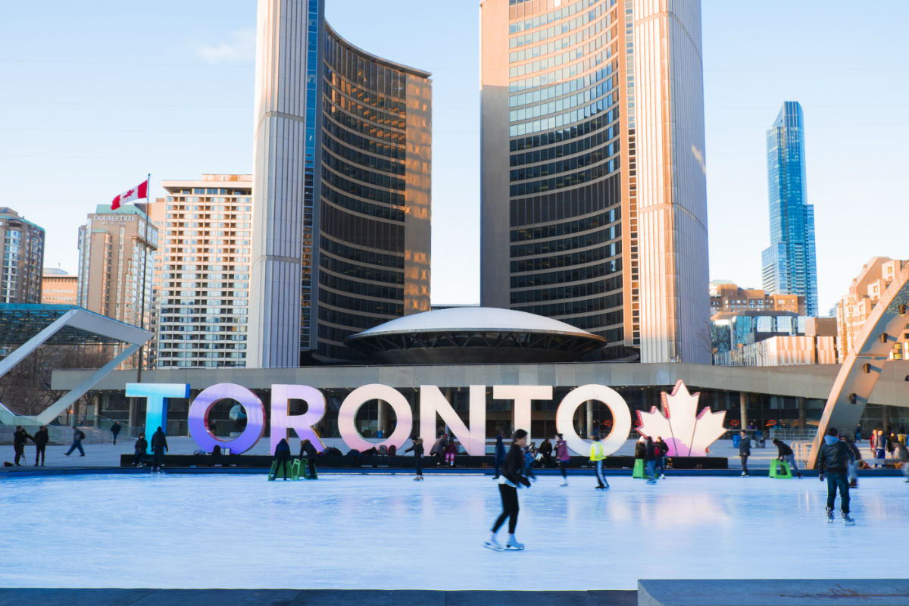

Slide 2
Moving to Toronto
1. The “Business problem”
1.1. Target audience- who may be interested?
2. Data Section:
2.1. Describe Data requirements and Sources needed to solve the problem
3. Methodology section:
3.1. Data processing
3.2. Exploratory data analysis
3.3. Machine learning algorithms used.
4. Results section:
4.1. Discussion of the results and findings
5. Discussion section:
5.1. Discussion of observations noted and any recommendations
6. 6. Conclusion section:
6.1. Options and conclusions.

Slide 3
Moving to Toronto
Discussion and Background of the Business Problem:
An executive manager has been expatriated to Toronto City and has to look for a new family home in one of its neighbourhoods
The key criteria to take into consideration are:
Family needs
good rated elementary schools for his young children
the presence of plenty of malls for his wife.
Personal needs.
the existence of gyms in the chosen neighbourhood
Criteria excluded:
criminality factor due to Toronto has low crime rates
cost of rental housing as it is included in the expatriation package

Slide 4
Moving to Toronto
1.1 Target Audience:
Investors who could benefit from the model to assess real estate investments
Commercial Real Estate Brokers encouraged to offer brokerage services
Big Corporations interested in relocation processes for their expats.
Public Administration to right size their infrastructures to attract foreign talent
Toronto residents keen on taking data driven decisions based on the model
Individuals in expatriation situation who may have to face a similar situation

Slide 5
Moving to Toronto
2. Data Preparation:
Packages, if missing
beautifulsoup4 to scrape websites
geopy to geocode web services and to locate the coordinates of addresses, cities, countries, and landmarks across the globe using third-party geocoders and other data sources
folium to visualize data that’s been manipulated in Python on an interactive leaflet map.It enables both the binding of data to a map visualization as well as passing rich vector/raster/HTML visualizations as markers on the map
Libraries
numpy # to handle data in a vectorized manner
pandas # for data analysis
json # to handle JSON files
Nominatim # to convert an address into latitude and longitude values
requests # to handle requests
json_normalize # to tranform JSON file into a pandas dataframe
matplotlib and associated # to plotting graphsmodules
sklearn # to use machine learning k-means at clustering stage
folium # to map rendering
geocoder # to get coordinates

Slide 6
Moving to Toronto
2. Data Sources:
Wikipedia
https://en.wikipedia.org/wiki/List_of_postal_codes_of_Canada:_M
Foursquare API
https://developer.foursquare.com/docs/resources/categories
GeoSpace data
https://open.toronto.ca/dataset/community-council-boundaries/
Websites
ontario.compareschoolrankings.org

Slide 7
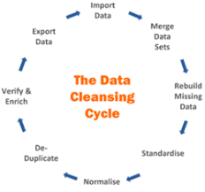
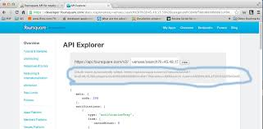
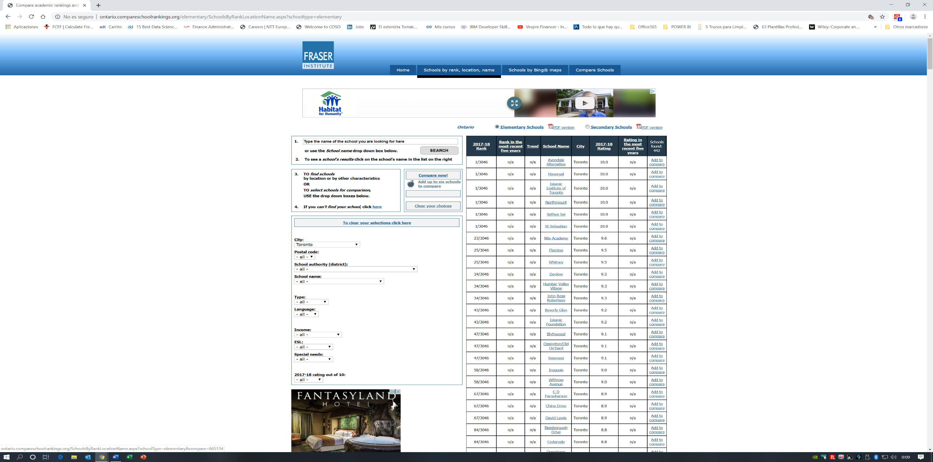
Moving to Toronto
3. Methodology section:
3.1 Data Processing:
Data wrangling process for Wikipedia source input
Quality rules applied
API Foursquare
Extracting Venue Types information
Gym
Mall
Website ontario.compareschoolrankings.org
building file with extracted information

Slide 8
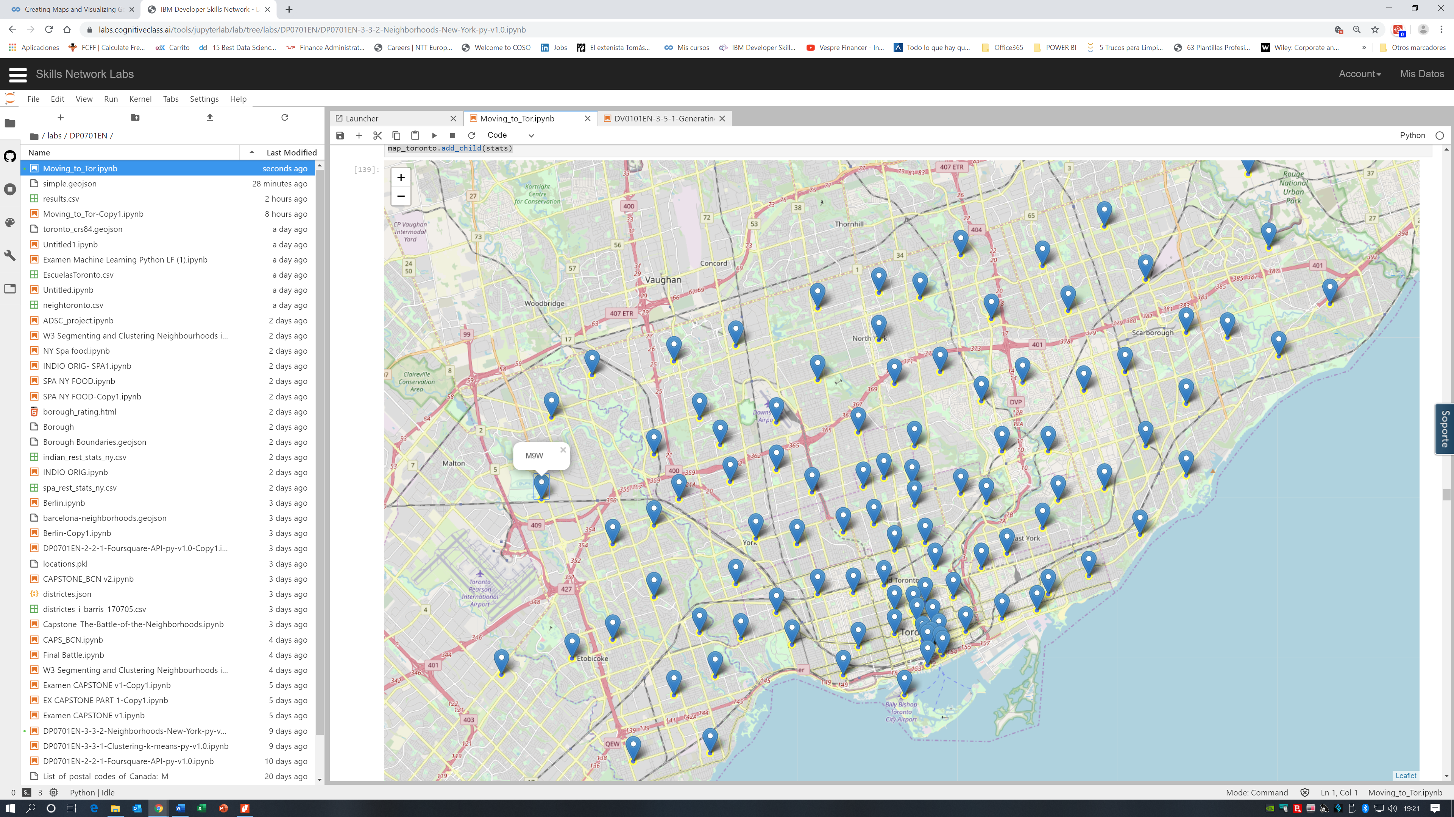
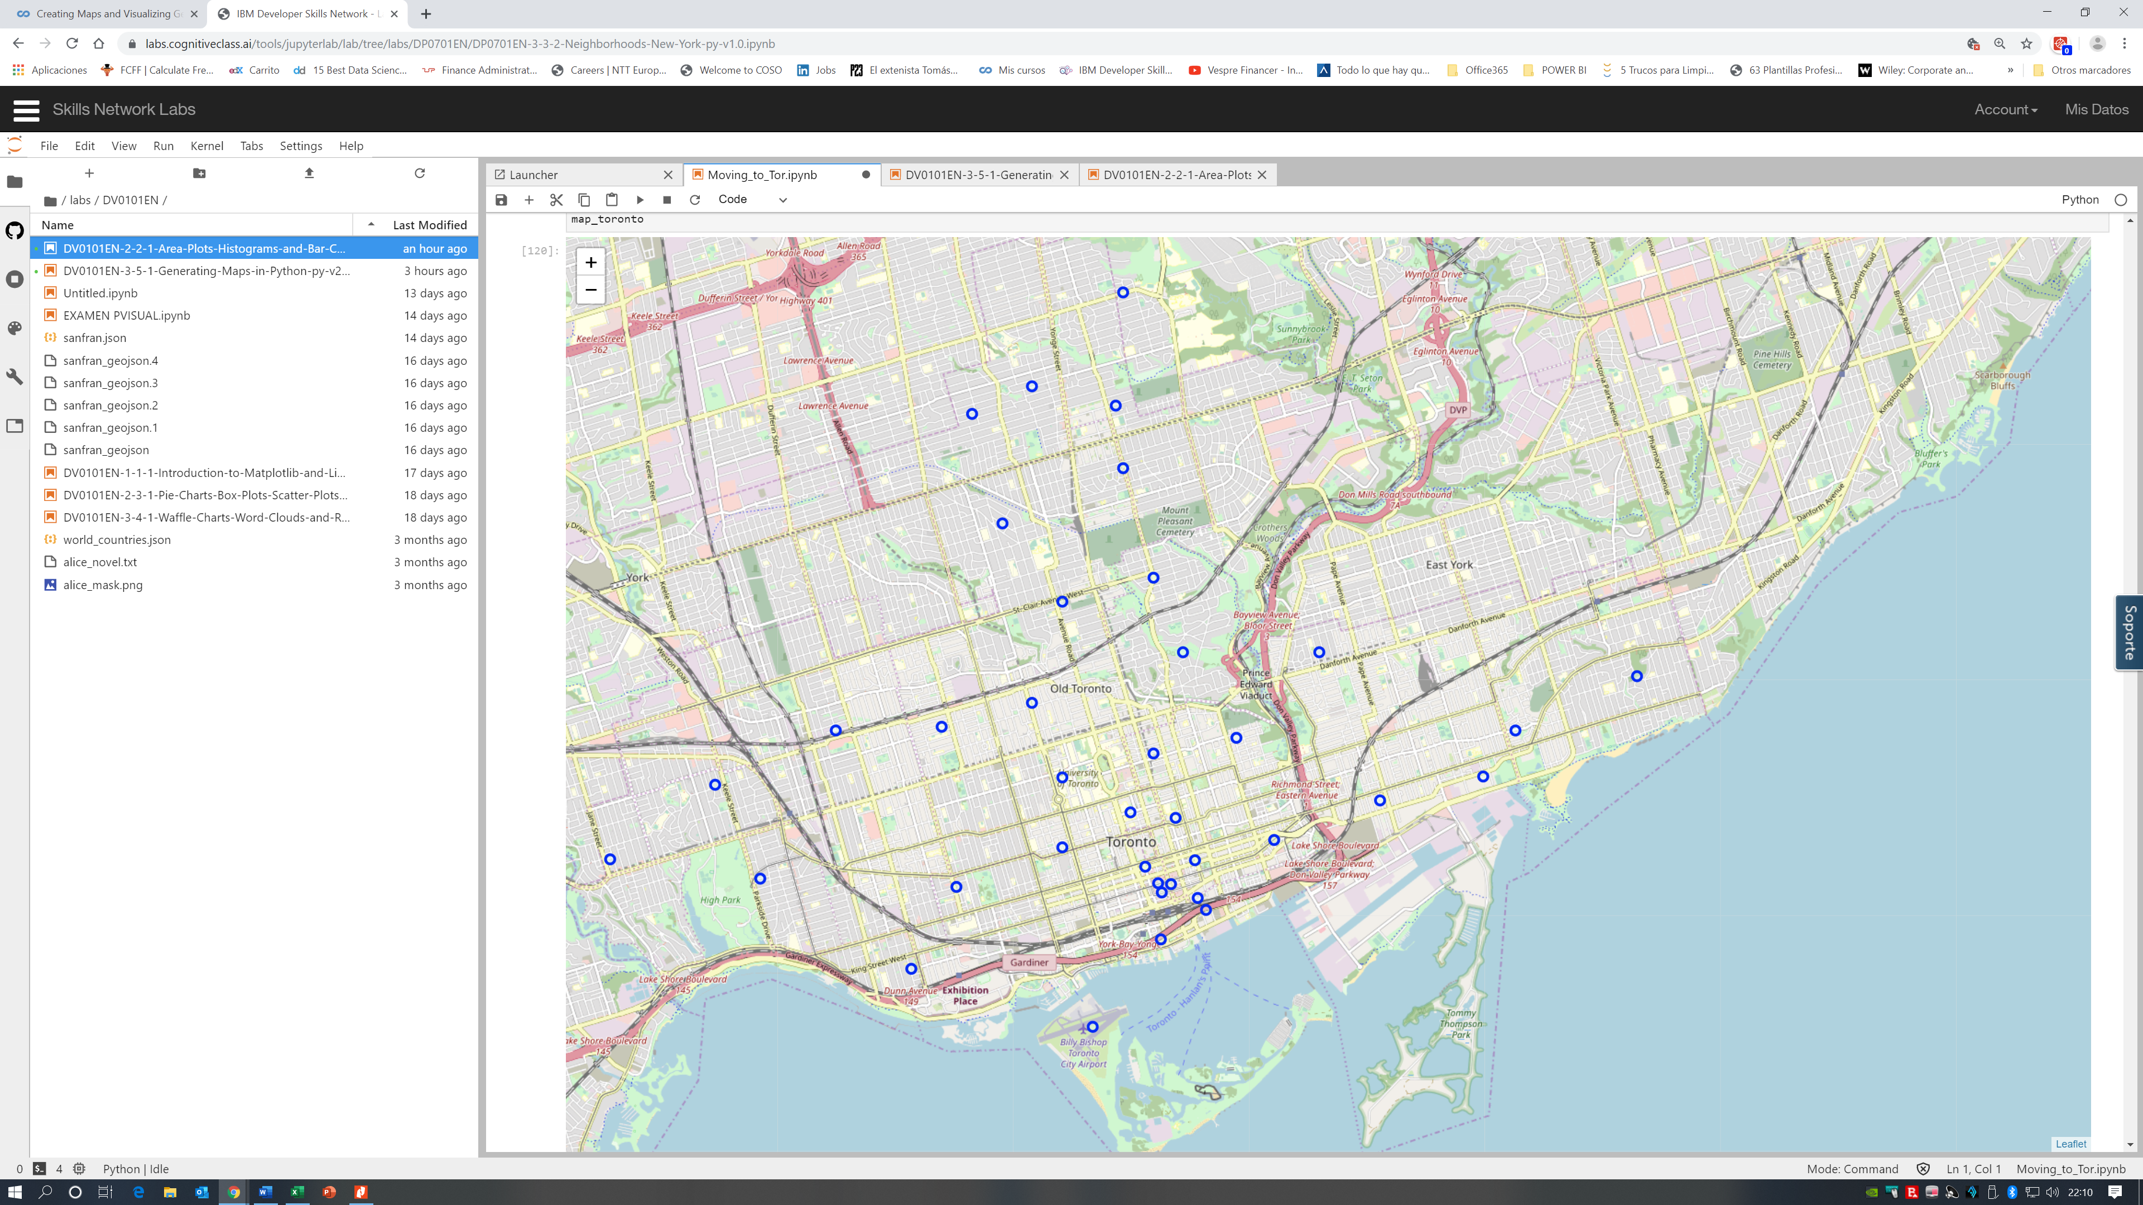
Moving to Toronto
3. Methodology section:
3.1 Data Processing:
FROM TO
Appying business decisión: Only part of Greater Toronto area

Slide 9
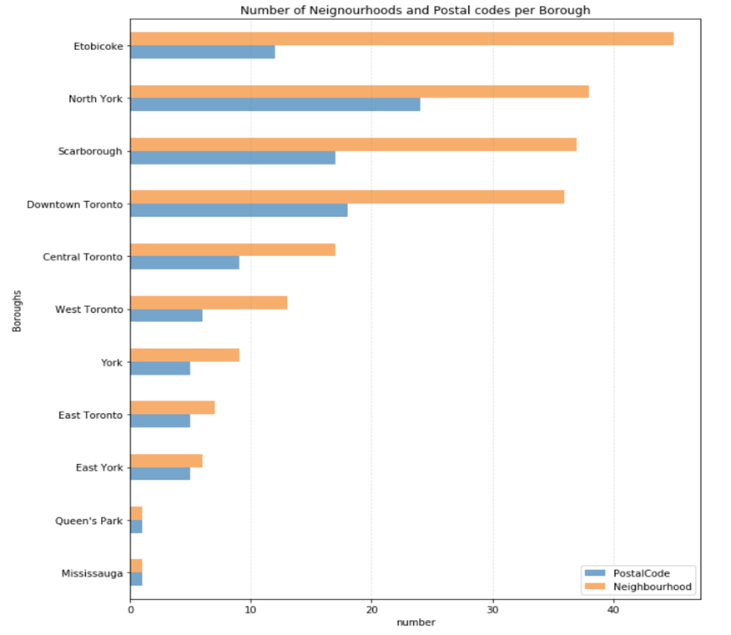
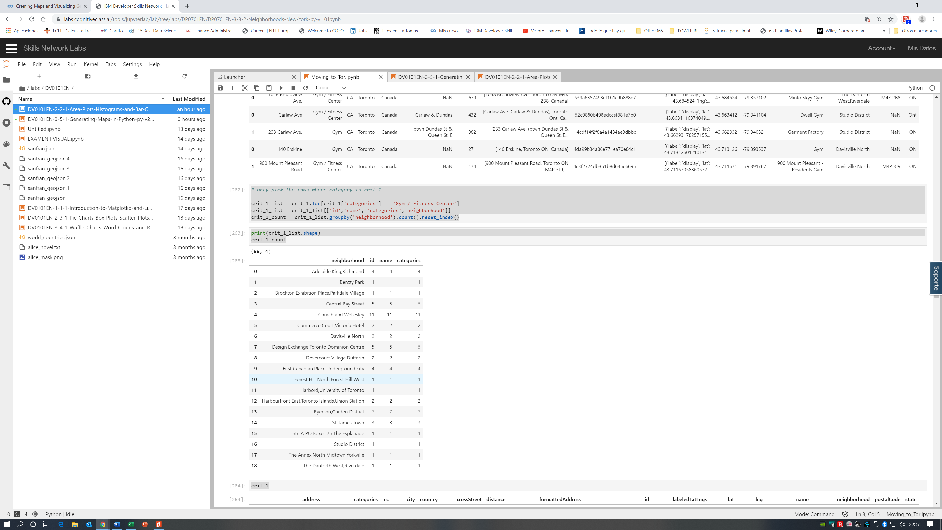
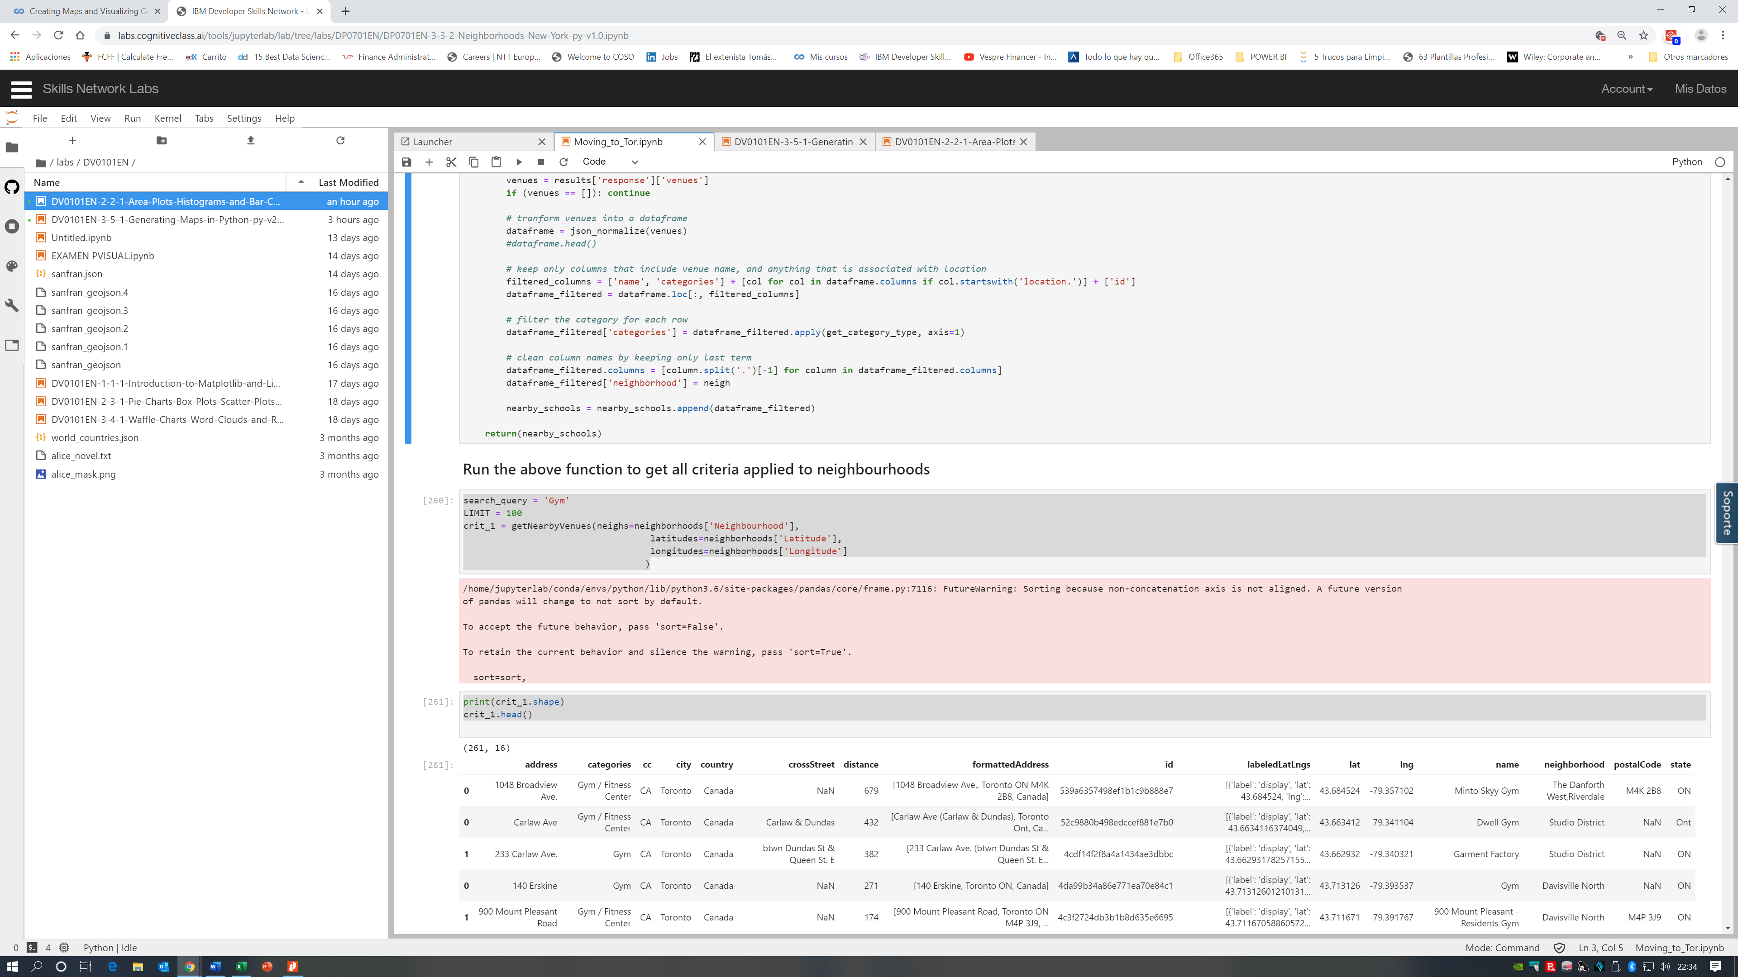
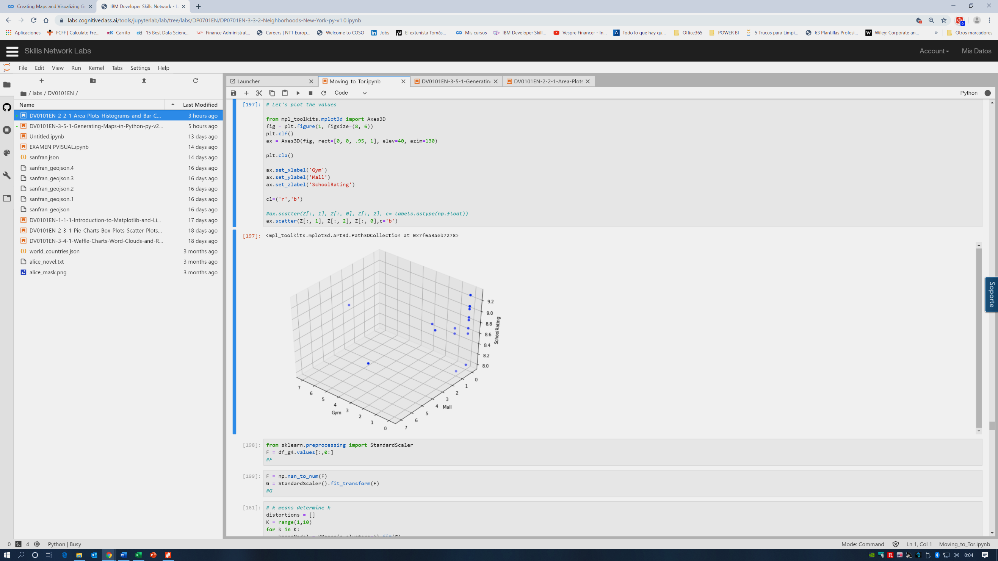
Moving to Toronto
3. Exploratory Analysis:
List of values
Range of values
Distribution
of values
Level of detail

Slide 10

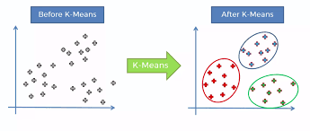
Moving to Toronto
3. Exploratory Analysis:
3.3. Machine learning algorithms used:
Using scikits learn libray
We apply k-means clustering :
a method of vector quantization, aims to partition n observations into k clusters in which each observation belongs to the cluster with the nearest mean, serving as a prototype of the cluster.
We apply K means as it is one of the algorithms that can be used for items segmentation
K-Means can group data only
unsupervised based on the similarity of items to each other.

Slide 11
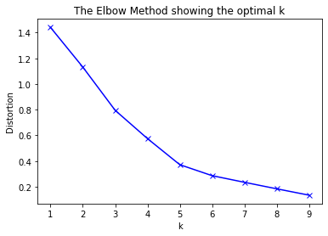
Moving to Toronto
3. Exploratory Analysis:
3.3. Machine learning algorithms used:
In order to determine the optimal k number, we’ll apply the elbow method
We will use k=5 to find the clusters

Slide 12
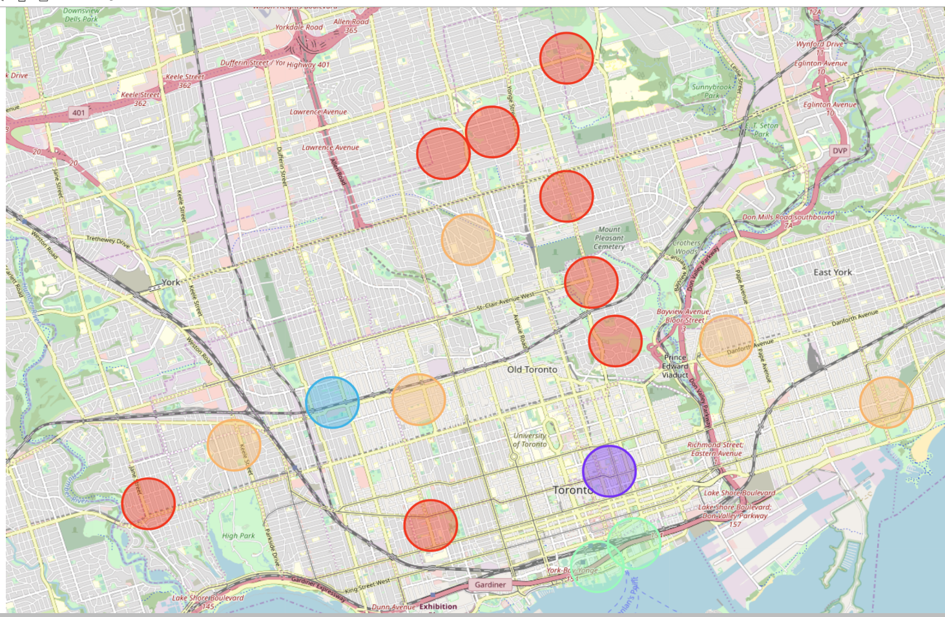
Moving to Toronto
4. Results:
5 clusters

Slide 13
Moving to Toronto
4. Results:
5 clusters :
Cluster 0 (red) have the best ranked schools but no scores in Gym nor Mall
Cluster 4 (orange) it’s the group that scores either on Gym either on Malls but never on both
Cluster 3 (green) scores on both Gym and Mall but low
Cluster 1 (purple) and Cluster 2 (blue) offer above 8.7 in schools and higher scores in Gym and Mall than Cluster 3
Cluster 1 scores more in Gym than Cluster 2 and vice versa
A trade-off decision
Cluster 2 :
Dovercourt Village
Dufferin
Cluster 1 :
Ryerson
Garden District

Slide 14
Moving to Toronto
6. Conclusion:
A choice among 4 neighbourhoods in 2 clusters
It’s clear than many more criteria could be added to refine the decision adding more complexity
and a pitfall of this analysis could be the consideration of only one major area of Toronto, taking into account all the areas may be would have provided a more realistic picture.
Furthermore, this results also could potentially vary if we use some other clustering techniques like DBSCAN.
Cluster 2 :
Dovercourt Village
Dufferin
Cluster 1 :
Ryerson
Garden District

Slide 15
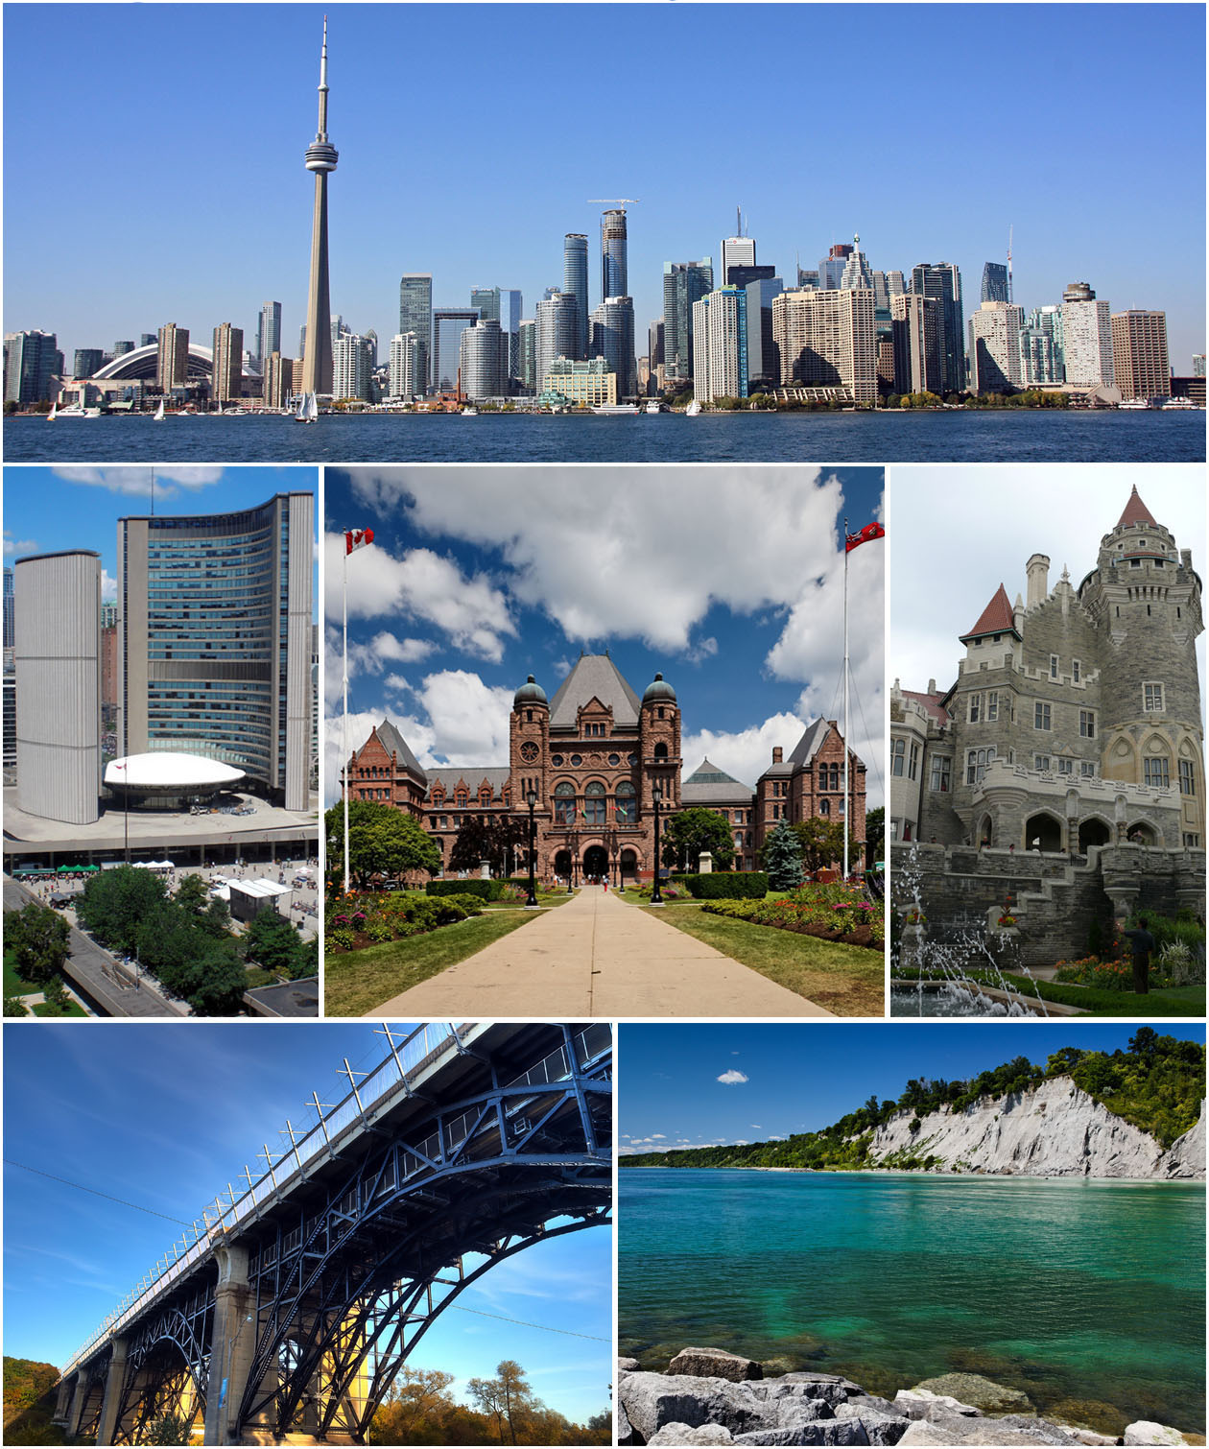
Thanks !

